Slide 1

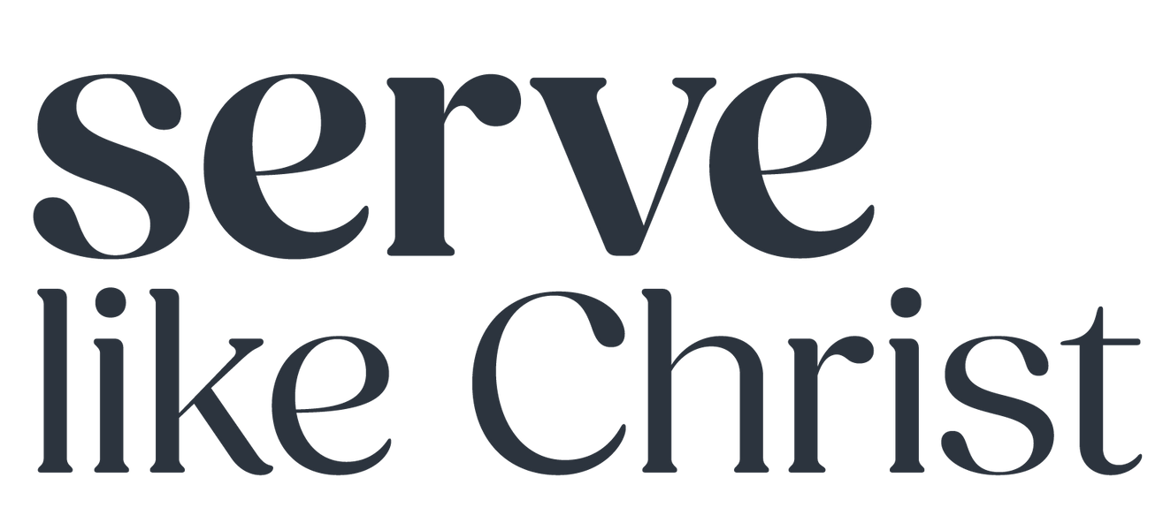



Slide 2

Having unpacked how missional leadership is shaped by prayer in Session One, Session Two aims to put region-specific, practical next steps in place. Join us for a facilitated conversation that welcomes a collaborative church approach with a heart for our communities and region, based on Matthew 28: 16 - 20
Having unpacked how missional leadership is shaped by prayer in Session One, Session Two aims to put region-specific, practical next steps in place.
Join us for a facilitated conversation that welcomes a collaborative church approach with a heart for our communities and region, based on Matthew 28: 16 - 20.
Let’s get practical!

Slide 3

Missional Leadership is Shaped by Prayer
Matthew 28: 16 - 20
Session One Summary
~ We lead with the mission in mind = missional leadership
~ Prayer shapes and impacts our leadership and the mission.
~ We considered the mission and leadership in light of:
Our plans, the world’s plans, or God’s plans? Our timing, the world’s timing, or God’s timing?
What is God’s mission? Is Matt 28: 19 God’s mission too?
Consider Luke 4: 18 – 19, Acts 13:22 and Ps 146: 5 – 10 and discuss what is on God’s heart.
God’s mission is what is on his heart for humanity and is intertwined in establishing his kingdom rule on Earth.
Key themes – Justice, righteousness, mercy, for all to know him, reconciliation, freedom, salvation, relationship, and love.

Slide 4
How Prayer Impacts Our Leadership and The Mission
Matthew 28: 16 – 20
What is prayer?
Consider current prayer practices and rhythms that foster or facilitate prayer for mission and missional leadership.
Do you notice any gaps in the ‘prayer space’ when it comes to mission and missional leadership? What needs to change or be added to, that fosters prayer into the vision, mission, leadership and way things are implemented and outworked?

Slide 5
Putting it all together – a facilitated conversation
Matthew 28: 16 – 20
A few questions, to start the conversation, where we all can contribute.
How well do we know our region? Our suburb, wider community, city or town. Should we even be praying for our region? Needs of the region? Strengths of the region?
Who can we work alongside and pray for – NPOs, other churches, community groups etc? How? Who is coordinating this?
Can we ‘do’ missional leadership without prayer? Do we want to?
How are we encouraging the people we lead to be in prayer for ‘others’, what does our personal prayer time look like for the region?
What about praying for the region at a ministry or church level? Why should we?
Do we need more prayer meetings or can we tweak and work off what is already there, in our context?
How vague or specific, how cautious or bold are our prayers – individually and corporately?
How can we support one another – in different churches?

Slide 6
Prayer Practices That Impact Missional Leadership
Matthew 28: 16 – 20
Prayerful missional leadership is the goal.
Missional Leadership and its practical, day-to-day outworking is to be soaked in prayer.
What’s the ‘one-next thing’ you can do in your context that will foster this kind of prayer?

